Slide 1
19Z504 COMPUTER NETWORKS
Physical Layer

Slide 2
Physical Layer
Signal Characteristics
Signal Encoding Techniques
Transmission Media
Performance Metrics - Problems

Slide 3
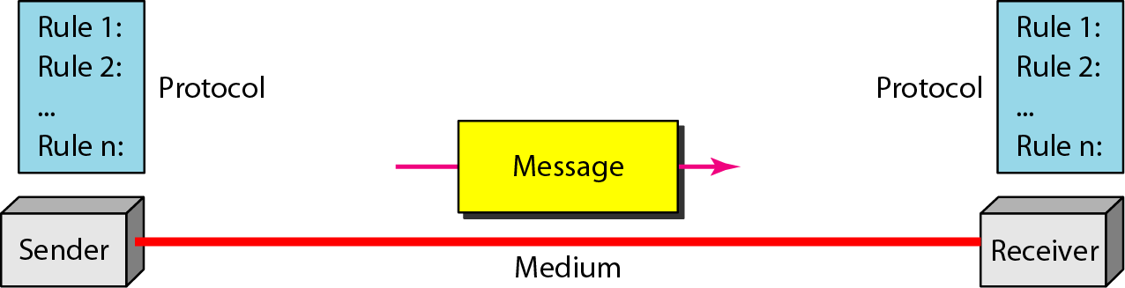
Components of a data communication system

Slide 4
Physical Layer
The basic building block of any communications facility is the transmission line.
Information can be communicated by transmitting signal over some medium (transmission line) .
The most commonly used transmission media are twisted-pair lines, coaxial cable, optical fiber cable, and terrestrial and satellite microwave.
The successful transmission of data depends principally on two factors:
the quality of the signal being transmitted
the characteristics of the transmission medium.

Slide 5
Data & Signal
Data refers to information presented in whatever form is agreed upon by the parties creating and using the data.
A signal is an electrical or electromagnetic current (or light if optical fiber) that is used for carrying data from one device or network to another
Transmission is the communication of data by the propagation and processing of signals.
Data is encoded in some electrical or electromagnetic(or optical) form to produce analog or digital signals.
The process by which computer interacts with the network transmission media and sends the signal down the media is referred to as signalling.
Both Data and Signal can be
Analog
Digital

Slide 6
Analog & Digital Data
Analog data refers to information that is continuous;
Eg: an analog clock that has hour, minute, and second hands gives information in a continuous form; ie - the movements of the hands are continuous.
Analog data are continuous and take continuous values.
Digital data refers to information that has discrete states
Eg: a digital clock that reports the hours and the minutes will change suddenly from 8:05 to 8:06.
Digital data have discrete states and take discrete values.

Slide 7
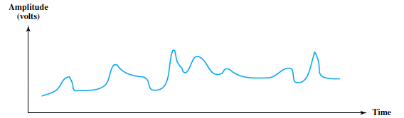
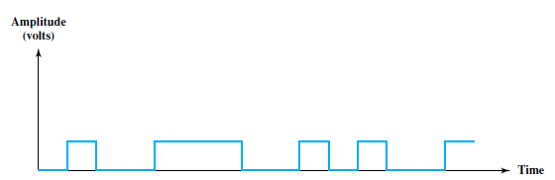
Analog Signal Vs Digital Signal
Analog Signal
Digital Signal
An analog signal is one in which the signal intensity varies in a smooth fashion over time.
(ie)there are no breaks or discontinuities in the signal
The continuous signal might represent speech.
Analog signals can have an infinite number of values in a range
A digital signal is one in which the signal intensity maintains a constant level for some period of time and then abruptly changes to another constant level.
discrete signal might represent binary 1s and 0s.
digital signals can have only a limited number of values.

Slide 8
Time Domain Concepts
Both analog and digital signals can take one of two forms:
periodic
Non-periodic/aperiodic
In data communications, we commonly use
periodic analog signals (because they need less bandwidth,)
Non-periodic digital signals (because they can represent variation in data).

Slide 9
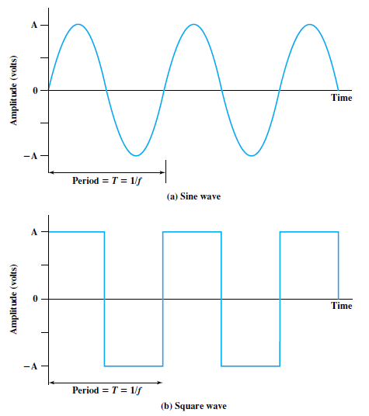
Periodic signal
The simplest sort of signal is a periodic signal, in which the same signal pattern repeats over time.
The completion of one full pattern is called a cycle

Slide 10
Simple Signal – sine wave
The sine wave is the fundamental periodic signal.
A general sine wave can be represented by three parameters:
peak amplitude (A)
frequency ( f ),
Phase (φ)

Slide 11
Peak Amplitude (A), Frequency (f ) ,Period(T) and Phase(φ)
Peak Amplitude is the maximum value or strength of the signal over time
This value is measured in volts(V).
Period of a signal, which is the amount of time it takes for one repetition.
Frequency is the rate at which the signal repeats.
It is measured in cycles per second, or Hertz (Hz).
Frequency is the rate of change with respect to time. Change in a short span of time means high frequency. Change over a long span of time means low frequency.
Frequency and period are the inverse of each other.
(ie) T= 1/ f
Phase is a measure of the relative position in time within a single period of a signal.
The term phase describes the position of the waveform relative to time 0.
Phase is measured in degrees(º) or radians(rad).
A phase shift of 360° corresponds to a shift of a complete period;
A phase shift of 180° corresponds to a shift of one-half of a period;
A phase shift of 90° corresponds to a shift of one-quarter of a period

Slide 12
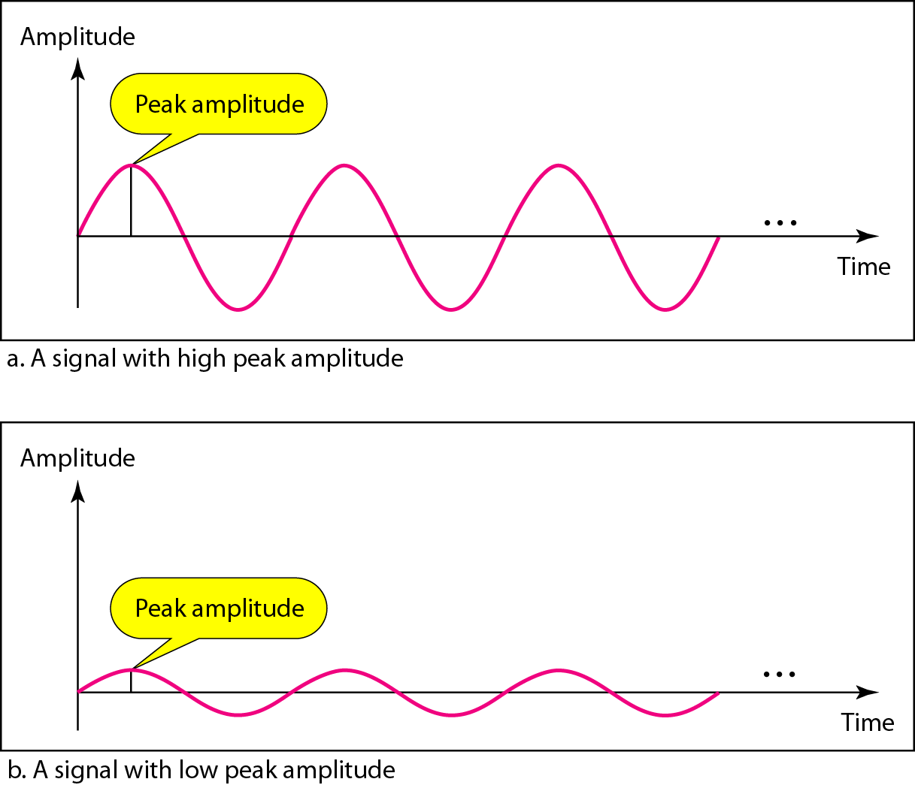
Two signals with the same Phase and Frequency,but different Amplitudes

Slide 13
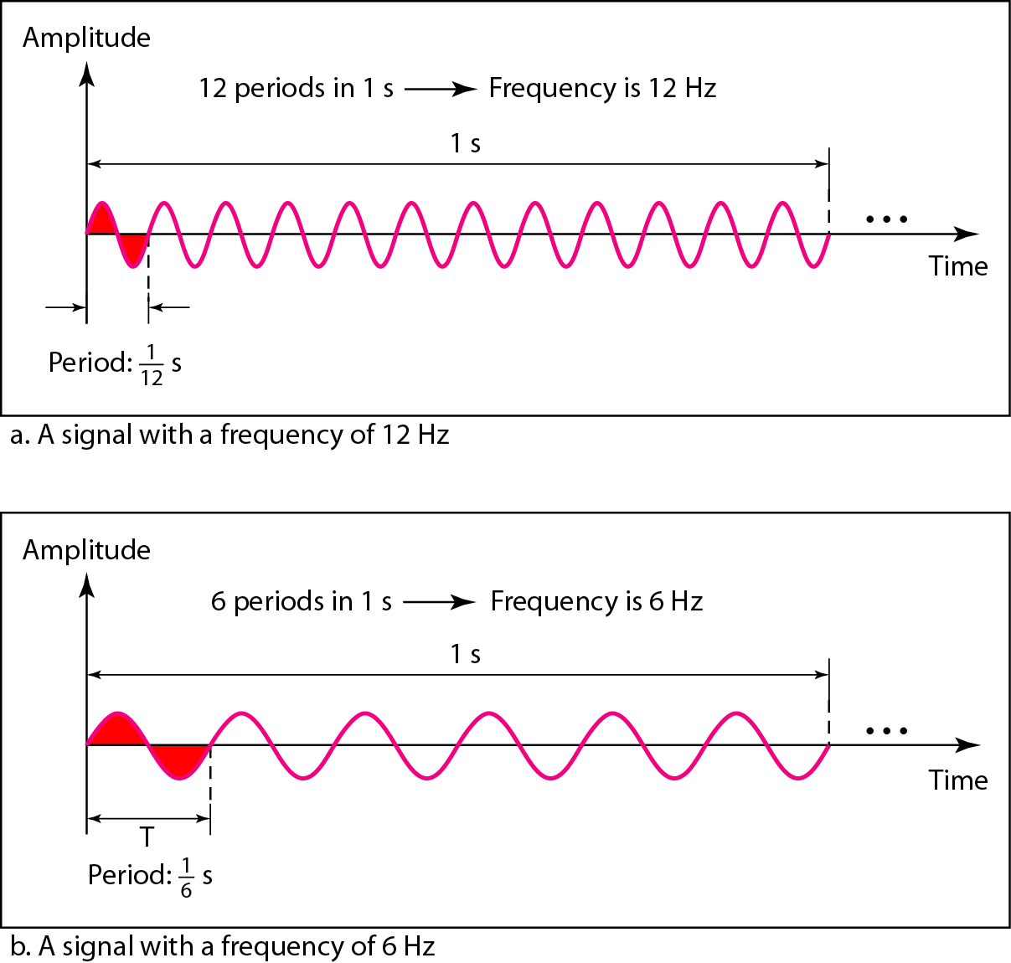
Two signals with the same Amplitude and Phase, but different Frequencies

Slide 14
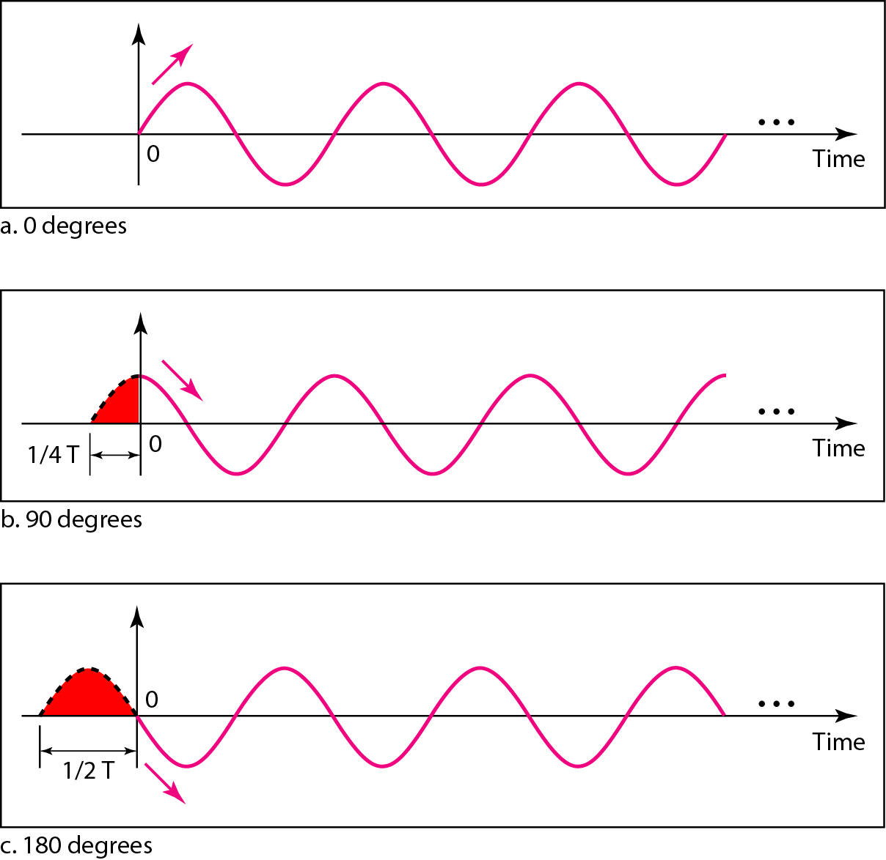
Three sine waves with the same Amplitude and Frequency, but different Phases

Slide 15
Wavelength
The wavelength is the distance a simple signal can travel in one period.
In data communications, we often use wavelength to describe the transmission of light in an optical fiber.
if we represent wavelength by λ, propagation speed by c (speed of light), and frequency by f, we get
Wavelength =propagation speed x period
= propagation speed/frequency

Slide 16
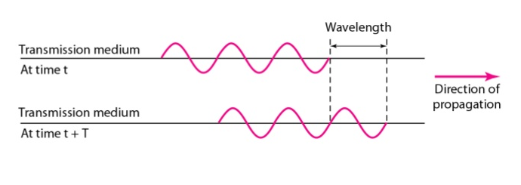
Wavelength and Period

Slide 17
Time & Frequency domain
The time-domain plot shows changes in signal amplitude with respect to time
Phase is not explicitly shown on a time-domain plot.
To show the relationship between amplitude and frequency, we can use what is called a frequency-domain plot.
A frequency-domain plot is concerned with only the peak value and the frequency
Changes of amplitude during one period are not shown
A complete sine wave in the time domain can be represented by one single spike in the frequency domain.

Slide 18
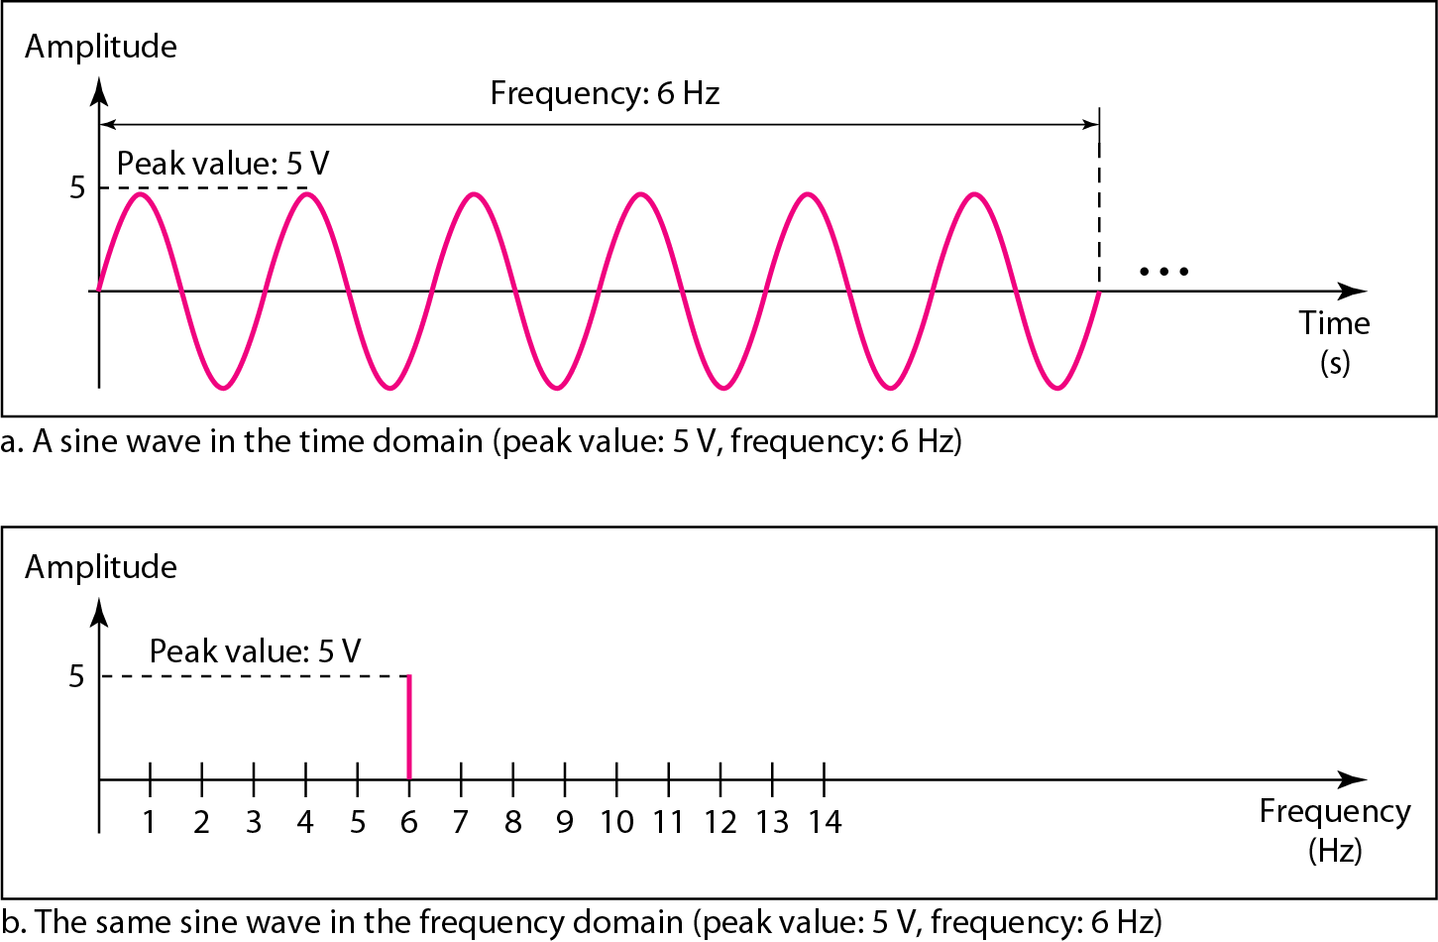
The time-domain and frequency-domain plots of a sine wave

Slide 19
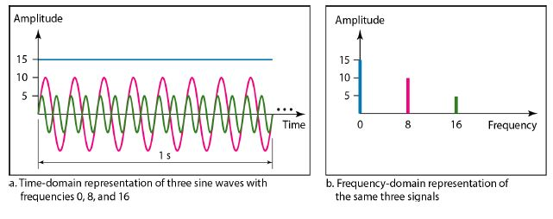
Frequency domain
The frequency domain is more compact and useful when we are dealing with more than one sine wave.

Slide 20
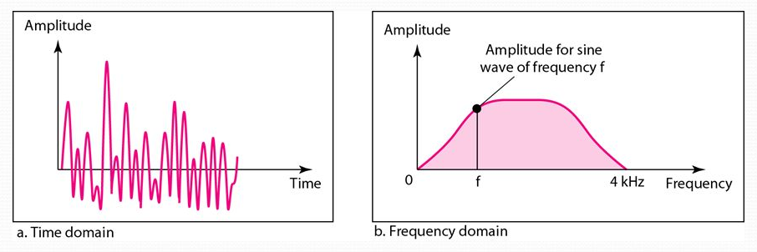
The time and frequency domains of a nonperiodic signal

Slide 21
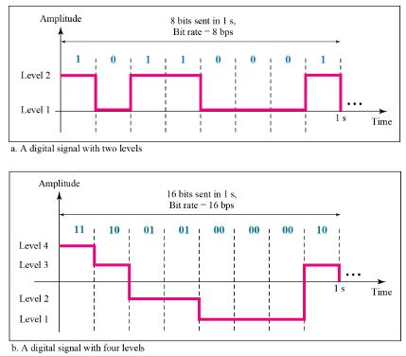
DIGITAL SIGNALS
Information can also be represented by a digital signal.
Eg:
1 can be encoded as a positive voltage
0 as zero voltage.
A digital signal can have more than two levels.
send more than 1 bit for each level
If a signal has L levels, each level needs log₂L bits.

Slide 22
How many bits per level?
A digital signal has eight levels. How many bits are needed per level?
Number of bits per level =log₂ 8 =3
Each signal level is represented by 3 bits.

Slide 23
Bit Rate/frequency
Most digital signals are non-periodic.
The bit rate is the number of bits sent in one second, expressed in bits per second (bps).

Slide 24
Bit rate of the channel?
Assume we need to download text documents at the rate of 100 pages per minute. What is the required bit rate of the channel?
Given: 100 pages per min download
A page is an average of
24 lines
80 characters in each line
assume that one character requires 8 bits,
Bit rate = 100 x 24x80x8 = 15,36,000bpm
=15,36,000/60 bps= 25,600bps
= 25.6kbps

Slide 25
Bit Length
The bit length is the distance one bit occupies on the transmission medium.
Bit length =propagation speed x bit duration

Slide 26
DATA RATE
Very important consideration in data communications:
How fast we can send data, in bits per second over a channel.
Data rate depends on three factors:
1. The bandwidth available
2. The level of the signals we use
3. The quality of the channel (the level of noise)
Two theoretical formulas were developed to calculate the data rate:
Nyquist Bit rate for a noiseless channel
Shannon capacity for a noisy channel.

Slide 27
Nyquist Bit Rate
For a noiseless channel, the Nyquist bit rate formula defines the theoretical maximum bit rate
BitRate = 2 x bandwidth x 1og₂ L
bandwidth is the bandwidth of the channel,
L is the number of signal levels used to represent data,
BitRate is the bit rate in bits per second.
Increasing the levels of a signal may reduce the reliability of the system
Consider the noiseless channel with a bandwidth of 3000 Hz transmitting a signal with four signal levels (for each level, we send 2 bits). The maximum bit rate can be calculated as
BitRate =2 x 3000 X log₂ 4 = 12,000 bps

Slide 28
Signal Encoding
Link is a physical medium carrying signals.
Links provide the foundation for transmitting all sorts of information, including the kind of data we are interested in transmitting—binary data (1s and 0s).
The binary data is encoded in the signal.
Encode the binary data that the source node wants to send into the signals that the links are able to carry and then to decode the signal back into the corresponding binary data at the receiving node
The network adaptor contains a signaling component that actually encodes bits into signals at the sending node and decodes signals into bits at the receiving node.

Slide 29
Signal Element Versus Data Element
In data communications, our goal is to send data elements.
In digital data communications, a signal element carries data elements
A data element is the smallest entity that can represent a piece of information: this is the bit.
data elements are what we need to send
Data elements are being carried
A signal element is the shortest unit (time wise) of a digital signal.
signal elements are what we can send
signal elements are the carriers.

Slide 30
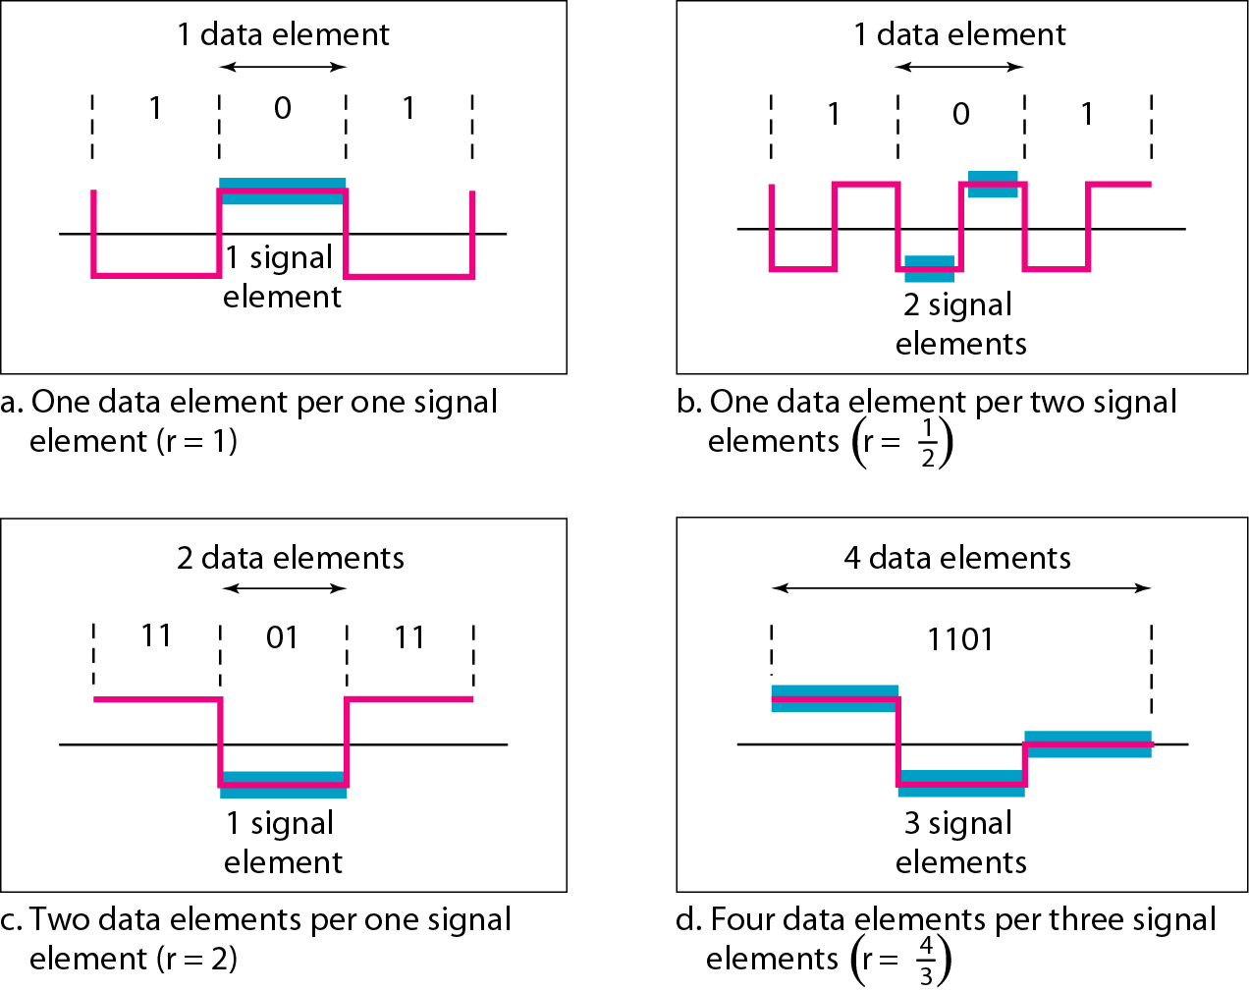
Signal Element versus Data Elements

Slide 31
Signal Element versus Data Elements
We define a ratio r which is the number of data elements carried by each signal element.
Suppose each data element is a person who needs to be carried from one place to another.
We can think of a signal element as a vehicle that can carry people.
When r = 1, it means each person is driving a vehicle.
When r > 1, it means more than one person is travelling in a vehicle (a carpool, for example).
We can also have the case where one person is driving a car and a trailer (r = 1/2 ).

Slide 32
Signal Element versus Data Elements
The data rate defines the number of data elements (bits) sent in 1s.
The unit is bits per second (bps).
The data rate is sometimes called the bit rate;
Increasing the data rate increases the speed of transmission;
The signal rate is the number of signal elements sent in 1s.
The unit is the baud.
The signal rate is sometimes called the pulse rate, the modulation rate, or the baud rate.
Decreasing the signal rate decreases the bandwidth requirement.
One goal in data communications is to increase the data rate while decreasing the signal rate.
In our vehicle-people analogy, we need to carry more people in fewer vehicles to prevent traffic jams. We have a limited bandwidth in our transportation system.

Slide 33
Encoding Problems
Baseline Wandering
The receiver keeps an average of the signal it has seen so far and then uses this average to distinguish between low and high signals.
Whenever the signal is significantly
lower than this average, the receiver concludes that it has just seen a 0;
higher than the average is interpreted to be a 1.
The problem is that too many consecutive 1s or 0s cause this average to change, making it more difficult to detect a significant change in the signal.

Slide 34




0 1 1 1
NRZ
BASE LINE WONDER
0 0 1 0 1
0 0 1
1 1

Slide 35
Encoding Problems
Clock Recovery / Synchronization Problem
Both the encoding and the decoding processes are driven by a clock—every clock cycle the sender transmits a bit and the receiver recovers a bit.
The sender’s and the receiver’s clocks have to be precisely synchronized in order for the receiver to recover the same bits the sender transmits.
The receiver derives the clock from the received signal—the clock recovery process.
Whenever the signal changes, such as on a transition from 1 to 0 or from 0 to 1, then the receiver knows it is at a clock cycle boundary, and it can resynchronize itself.
A long period of time without such a transition leads to clock drift.
Thus, clock recovery depends on having lots of transitions in the signal, no matter what data is being sent.

Slide 36
Signal Encoding Techniques
How we can represent digital data by using digital signals
The conversion involves three techniques:
line coding,
block coding,
scrambling.
Line coding is always needed
Block coding and scrambling may or may not be needed.

Slide 37
Line Coding
Line coding is the process of converting digital data to digital signals.
We assume that data, in the form of text, numbers, graphical images, audio, or video, are stored in computer memory as sequences of bits
Line coding converts the sequence of bits to a digital signal.
At the sender, digital data are encoded into a digital signal;
At the receiver, the digital data are recreated by decoding the digital signal.

Slide 38
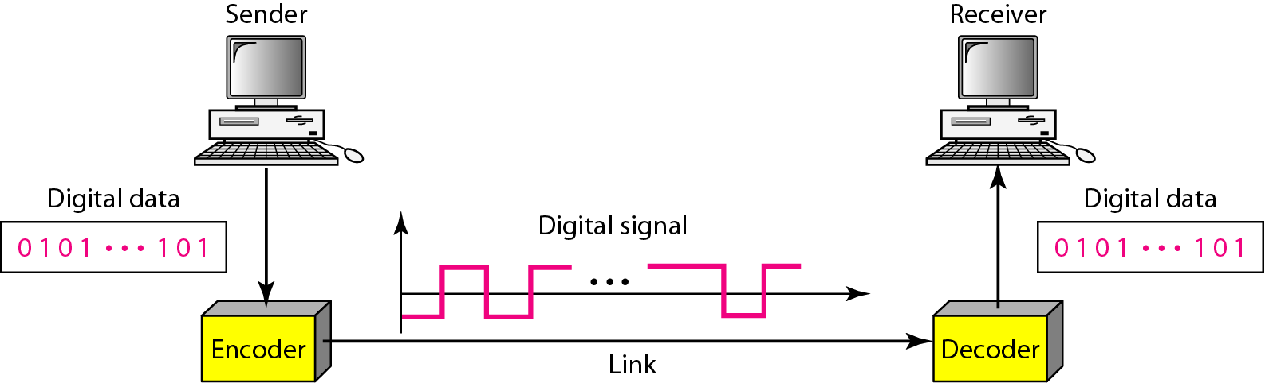
Line coding and decoding

Slide 39
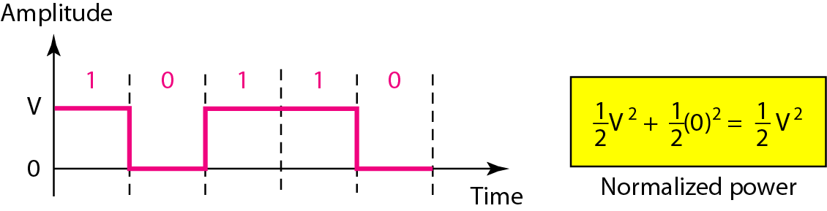
Line Coding Schemes
Unipolar Scheme
In a unipolar scheme, all the signal levels are on one side of the time axis, either above or below.
NRZ (Non-Return-to-Zero)
Traditionally, a unipolar scheme was designed as a non-return-to-zero (NRZ) scheme
Positive voltage defines bit 1 and the zero voltage defines bit 0
It is called NRZ because the signal does not return to zero at the middle of the bit.
This scheme is very costly.
For this reason, this scheme is normally not used in data communications today.

Slide 40
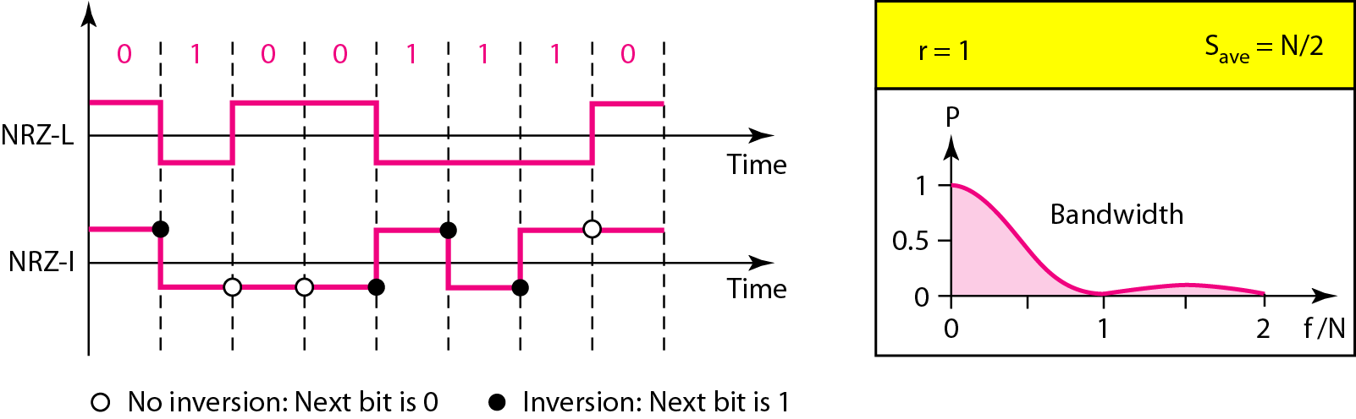
Line Coding Schemes
Polar Schemes
In polar schemes, the voltages are on the both sides of the time axis.
For example, the voltage level for 0 can be positive and the voltage level for 1 can be negative.
Non-Return-to-Zero (NRZ)
In polar NRZ encoding, we use two levels of voltage amplitude.
Two versions of polar NRZ: NRZ-L and NRZ-I
NRZ-L (NRZ-Level),
The level of the voltage determines the value of the bit.
High voltage -0 and Low voltage -1 (or)
High voltage -1 and Low voltage -0
Generally used in very short connections.
Has baseline wandering problem and synchronization problem
NRZ-I (NRZ-Invert),
The change or lack of change in the level of the voltage determines the value of the bit.
If there is no change, the bit is 0; if there is a change, the bit is 1.

Slide 41
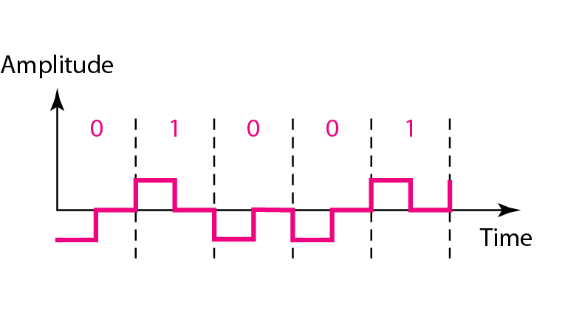
Line Coding Schemes
Return to Zero (RZ)
The main problem with NRZ encoding occurs when the sender and receiver clocks are not synchronized.
The receiver does not know when one bit has ended and the next bit is starting.
One solution is the return-to-zero (RZ) scheme, which uses three values:
positive, negative, and zero.
In RZ, the signal changes not between bits but during the bit.
The signal goes to 0 in the middle of each bit. It remains there until the beginning of the next bit. The main disadvantage of RZ encoding is that it requires two signal changes to encode a bit and therefore occupies greater bandwidth.
Problem is the complexity: RZ uses three levels of voltage, which is more complex to create and distinguish

Slide 42
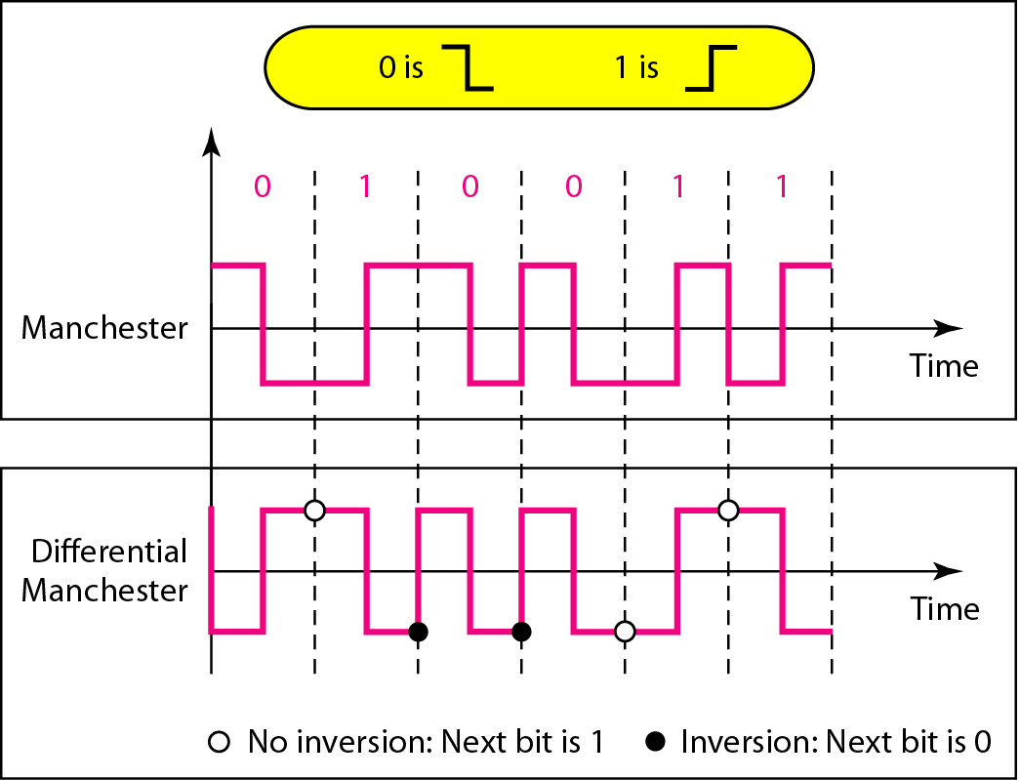
Line Coding Schemes
Biphase:
Manchester
The idea of RZ (transition at the middle of the bit) and the idea of NRZ-L are combined into the Manchester scheme.
In Manchester encoding, the duration of the bit is divided into two halves.
The voltage remains at one level during the first half and moves to the other level in the second half.
The transition at the middle of the bit provides synchronization.
Used by IEEE 802.3 Ethernet LAN
Differential Manchester,
Combines the ideas of RZ and NRZ-I.
There is always a transition at the middle of the bit, but the bit values are determined at the beginning of the bit.
If the next bit is 0, there is a transition; if the next bit is 1, there is none. No baseline Wandering

Slide 43
Block Coding
Block coding can give us redundancy and improve the performance of line coding.
Block coding is normally referred to as mB /nB coding;
it replaces each m-bit group with an n-bit group.
Block coding normally involves three steps:
division, substitution, and combination.
division step: a sequence of bits is divided into groups of m-bits.
substitution: substitute an m-bit group for an n-bit group is done
n-bit groups are combined together to form a stream. The new stream has more bits than the original bits

Slide 44
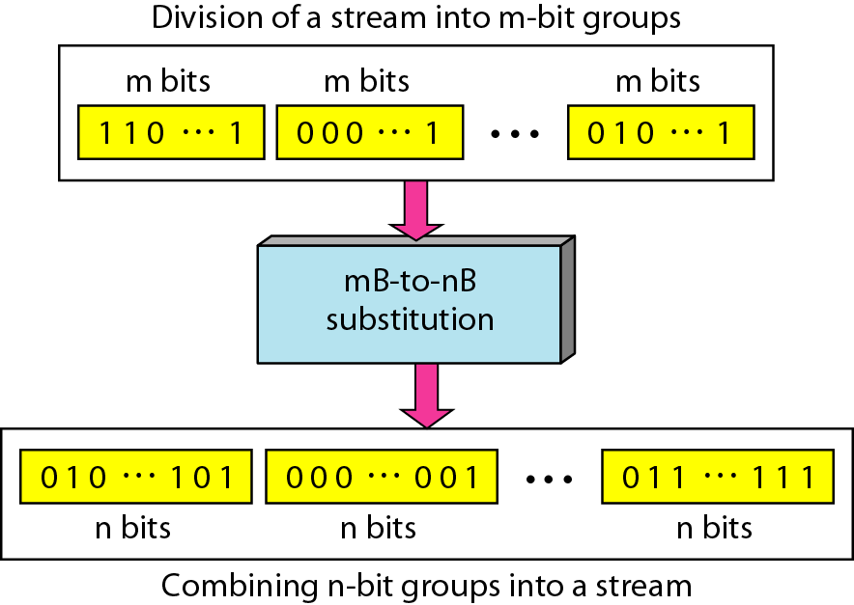
Block Coding

Slide 45
Block Coding
4B/5B
The four binary/five binary (4B/5B) coding scheme was designed to be used in combination with NRZ-I.
NRZ-I and 4B/5B
A long sequence make the receiver clock lose synchronization.
One solution is to change the bit stream, prior to encoding with NRZ-I, so that it does not have a long stream.
The 4B/5B scheme achieves this goal.
At the receiver, the NRZ-I encoded digital signal is first decoded into a stream of bits and then decoded to remove the redundancy

Slide 46
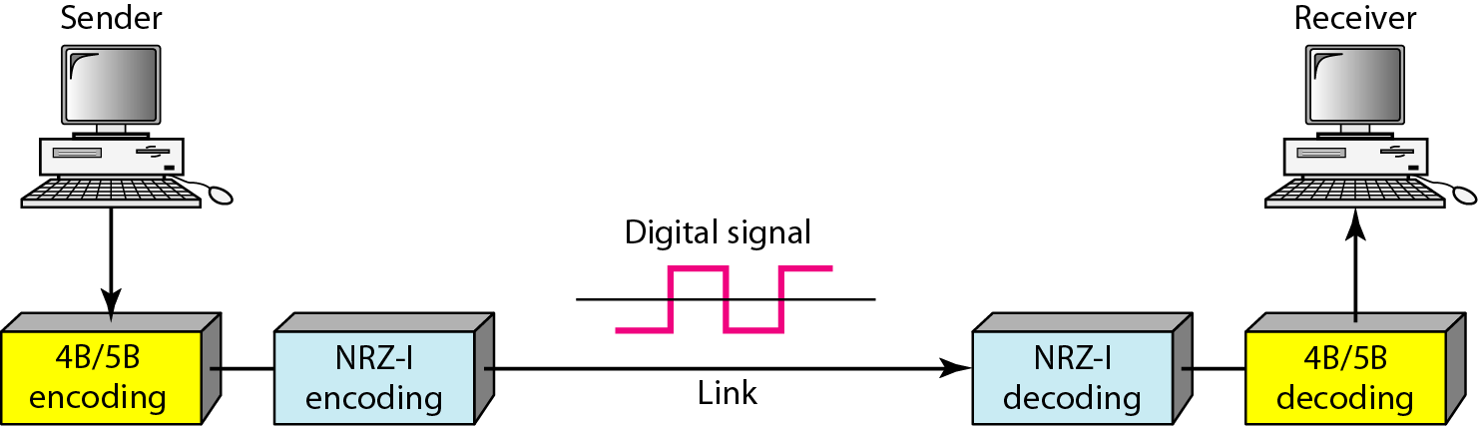
4B/5B

Slide 47

4B/5B Encoding
4B/5B block encoding scheme designed to breakup long strings of 0’s and 1’s.
In this scheme bit sequence is broken up in to four bit blocks.
Each block of four bit is replaced with a five bit block.
The five bits codes were selected so that there is no more than one leading zero and no more than two trailing zeros.
Only half of the five bits are used for encoding , the remaining codes can be used for other purposes.
Thus, when the codes are strung together there can be no more than three consecutive zeros
The string of bits after the replacement are transmitted using NRZI.
4B/5B encoding followed by NRZI is used in 10BaseTX (Fast Ethernet).

Slide 48

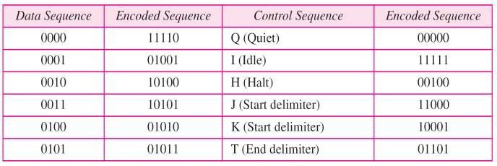
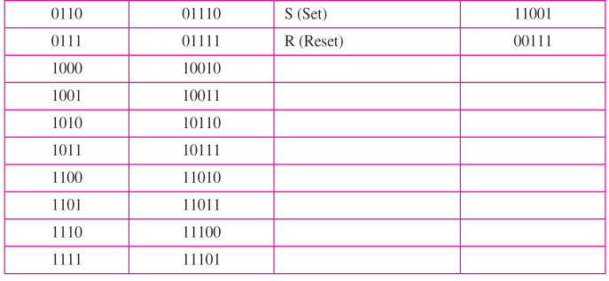
4B/5B Encoding

Slide 49









4B/5B Encoding
Bit Sequence
1 0 0 1 0 1 1 0 1 1 1 0
1 0 0 1
0 1 1 0
1 1 1 0
4B/5B Encoding
1 0 0 1 1 0 1 1 1 0
1 1 1 0 0
Not more than 3 consecutive zeros
1 0 0 1 1 0 1 1 1 0 1 1 1 0 0

Slide 50











Digital Signal
0 1 1 0
1
1 0 1 0
Digital data
1 0 1 0
Digital data
4B/5B
Encoder
NRZI
Encoder
Frame
NRZI
Decoder
4B/5B
Decoder
1 0 1 1 0
4B/5B Encoding
1 0 1 1 0

Slide 51
Transmission Medium
A transmission medium can be broadly defined as anything that can carry information from a source to a destination.
For example,
The transmission medium for two people having a dinner conversation is the air.
For a written message, the transmission medium might be a mail carrier, a truck, or an airplane
In data communications, the transmission medium is usually free space, metallic cable, or fiber-optic cable.
The information is usually a signal that is the result of a conversion of data from another form.
In telecommunications, transmission media can be divided into two broad categories:
Guided(wired)
Guided media include twisted-pair cable, coaxial cable, and fiber-optic cable.
Unguided(wireless)
Unguided medium is free space
Divided into three broad groups: radio waves, microwaves, and infrared waves

Slide 52
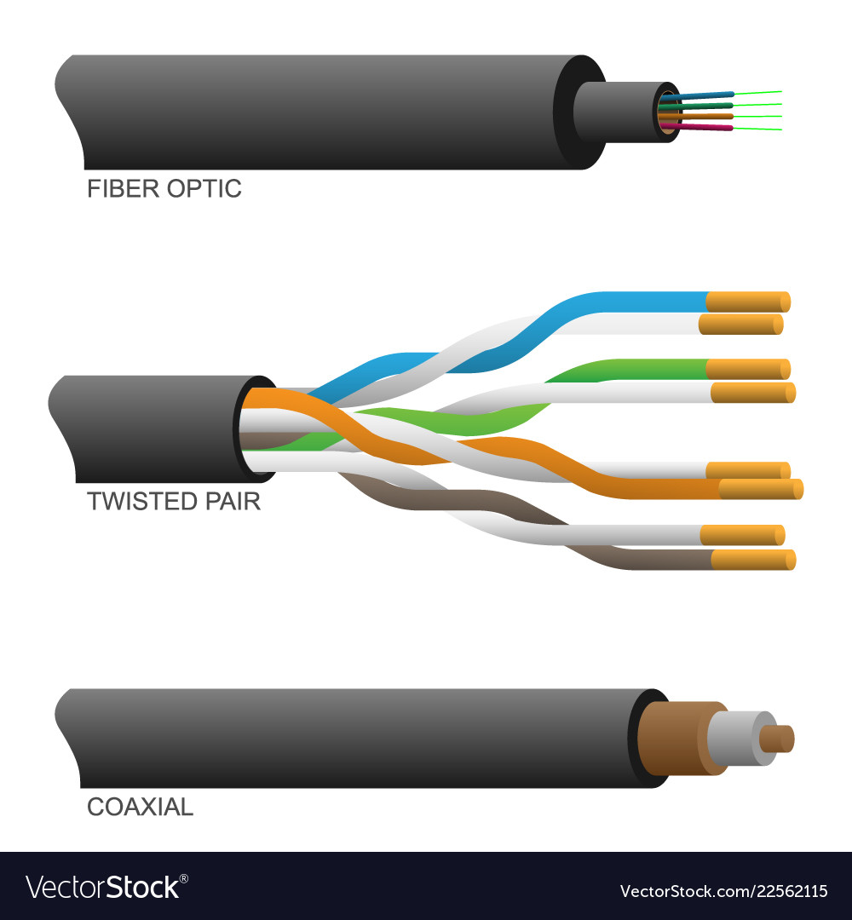
Wired Transmission Media
Guided media, are those that provide a conduit from one device to another.
Eg: twisted-pair cable, coaxial cable, and fiber-optic cable.
A signal traveling along any of these media is directed and contained by the physical limits of the medium.
Twisted-pair and coaxial cable use metallic (copper) conductors that accept and transport signals in the form of electric current.
Optical fiber is a cable that accepts and transports signals in the form of light.

Slide 53
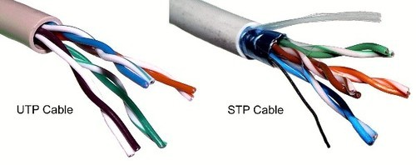
Twisted Pair
A twisted pair consists of two conductors (normally copper), each with its own plastic insulation, twisted together.
One of the wires is used to carry signals to the receiver, and the other is used only as a ground reference.
Types
unshielded twisted-pair (UTP).
shielded twisted-pair (STP).

Slide 54
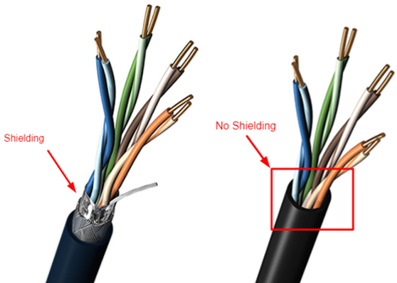
STP Vs UTP
STP cable has a metal foil or braided mesh-covering that encases each pair of insulated conductors while UTP does not.
metal casing improves the quality of cable by preventing the penetration of noise or crosstalk, but it is bulkier and more expensive

Slide 55
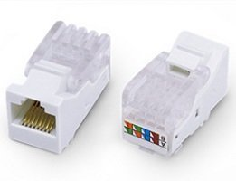
Twisted Pair Connector
The most common UTP connector is RJ45 (RJ stands for registered jack.
The RJ45 is a keyed connector, meaning the connector can be inserted in only one way.

Slide 56
Twisted Pair
Applications
Twisted-pair cables are used in telephone lines to provide voice and data channels.
The local loop-the line that connects subscribers to the central telephone office-commonly consists of unshielded twisted-pair cables.
The DSL lines that are used by the telephone companies to provide high-data-rate connections also use the high-bandwidth capability of unshielded twisted-pair cables.
Local-area networks, such as 10Base-T and 100Base-T, also use twisted-pair cables.

Slide 57
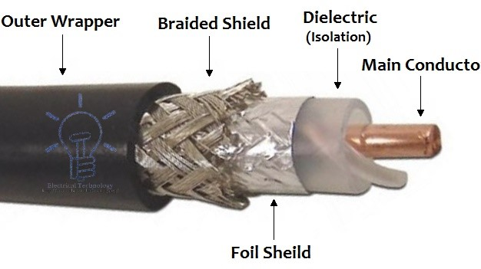
Coaxial Cable
Coaxial cable (or coax) carries signals of higher frequency ranges than those in twisted-pair cable.
coax has a central core conductor of solid or stranded wire (usually copper) enclosed in an insulating sheath, which is, in turn, encased in an outer conductor of metal foil, braid, or a combination of the two.
The outer metallic wrapping serves both as a shield against noise and as the second conductor, which completes the circuit.
This outer conductor is also enclosed in an insulating sheath, and the whole cable is protected by a plastic cover
Types
Baseband
Broadband

Slide 58
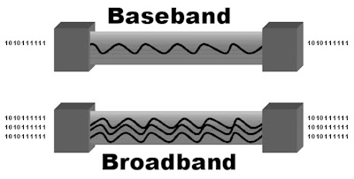
Baseband Vs Broadband
Baseband
This is a 50 ohm (Ω) coaxial cable which is used for digital transmission. It is mostly used for LAN’s. Baseband transmits a single signal at a time with very high speed.
Broadband
This uses analog transmission on standard cable television cabling. It transmits several simultaneous signal using different frequencies. It covers large area when compared with baseband coaxial cable.

Slide 59
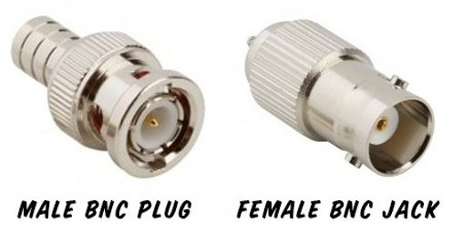
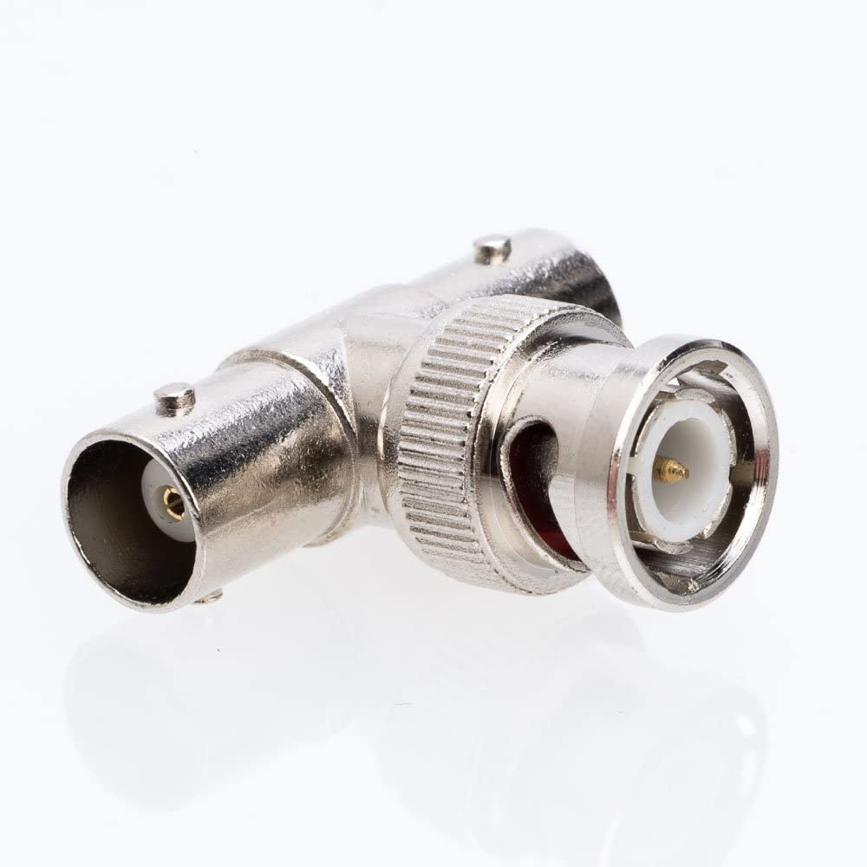
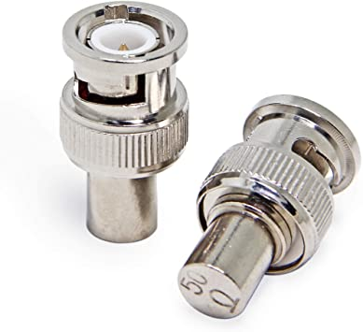
Coaxial Cable Connector
The most common type of connector used today is the Bayone-Neill-Concelman (BNC), connector.
Three popular types of connectors:
BNC connector,
BNC T connector,
BNC terminator.
The BNC connector is used to connect the end of the cable to a device, such as a TV set.
The BNC T connector is used in Ethernet networks to branch out to a connection to a computer or other device.
The BNC terminator is used at the end of the cable to prevent the reflection of the signal.

Slide 60
Coaxial Cable
Applications
In the traditional cable TV network, the entire network used coaxial cable.
hybrid networks use coaxial cable only at the network boundaries, near the consumer premises.
Another common application of coaxial cable is in traditional Ethernet LANs. Because of its high bandwidth, and consequently high data rate, coaxial cable was chosen for digital transmission in early Ethernet LANs.
The 10Base-2, or Thin Ethernet, uses RG-58 coaxial cable with BNC connectors to transmit data at 10 Mbps with a range of 185 m.
The 10Base5, or Thick Ethernet, uses RG-11 (thick coaxial cable) to transmit 10 Mbps with a range of 5000 m. Thick Ethernet has specialized connectors

Slide 61
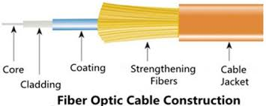
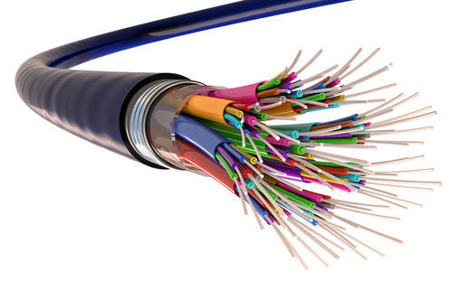
Fiber-Optic Cable
A fiber-optic cable is made of glass or plastic and transmits signals in the form of light.
Optical fibers use reflection to guide light through a channel.
A glass or plastic core is surrounded by a cladding of less dense glass or plastic.
The difference in density of the two materials must be such that a beam of light moving through the core is reflected off the cladding instead of being refracted into it.

Slide 62
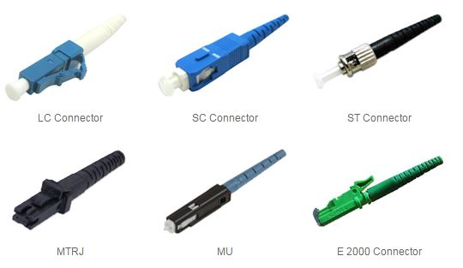
Fiber-Optic Cable Connector
Common three types:
The subscriber channel (SC) connector is used for cable TV. It uses a push/pull locking system.
The straight-tip (ST) connector is used for connecting cable to networking devices. It uses a bayonet locking system and is more reliable than SC.
MT-RJ is a connector that is the same size as RJ45.

Slide 63
Fiber-Optic Cable
Applications
Fiber-optic cable is often found in backbone networks because its wide bandwidth is cost-effective
Some cable TV companies use a combination of optical fiber and coaxial cable, thus creating a hybrid network. Optical fiber provides the backbone structure while coaxial cable provides the connection to the user premises. This is a cost-effective configuration since the narrow bandwidth requirement at the user end does not justify the use of optical fiber.
Local-area networks such as 100Base-FX network (Fast Ethernet) and 1000Base-X also use fiber-optic cable.

Slide 64
Wireless Transmission Media
Unguided media transport electromagnetic waves without using a physical conductor.
This type of communication is often referred to as wireless communication.
Signals are normally broadcast through free space and thus are available to anyone who has a device capable of receiving them.
Unguided signals can travel from the source to destination in several ways:
Ground propagation,
sky propagation,
line-of-sight propagation,

Slide 65
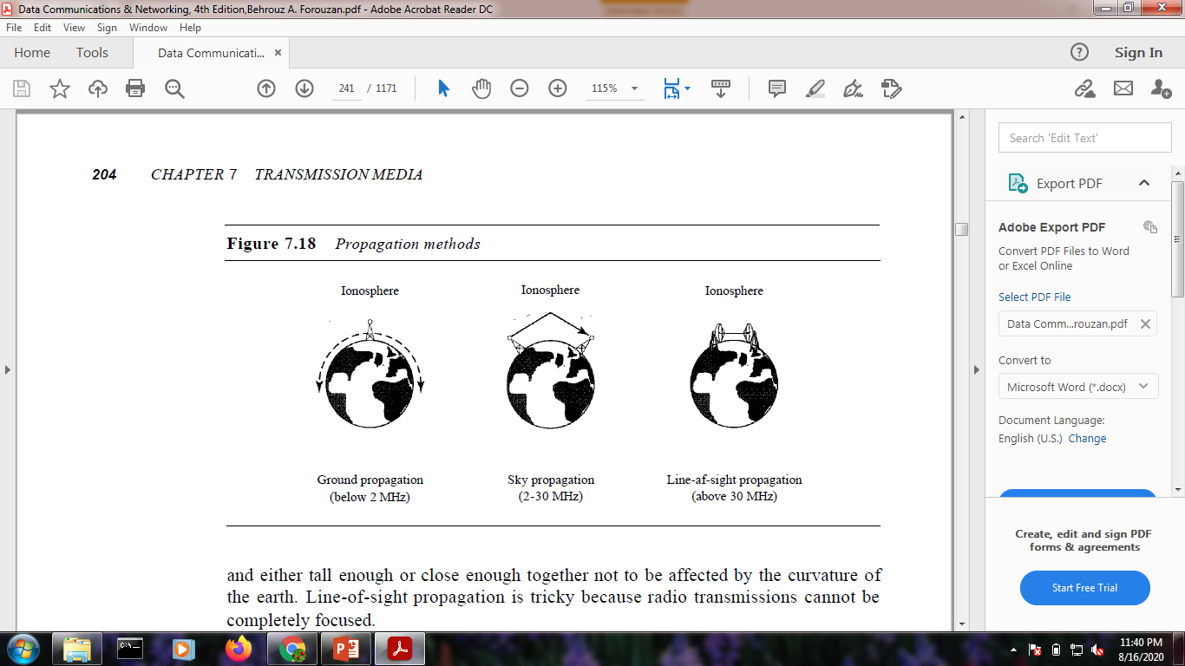
Wireless Transmission Media
In ground propagation, radio waves travel through the lowest portion of the atmosphere, hugging the earth.
In sky propagation, higher-frequency radio waves radiate upward into the ionosphere (the layer of atmosphere where particles exist as ions) where they are reflected back to earth.
In line-or-sight propagation, very high-frequency signals are transmitted in straight lines directly from antenna to antenna

Slide 66
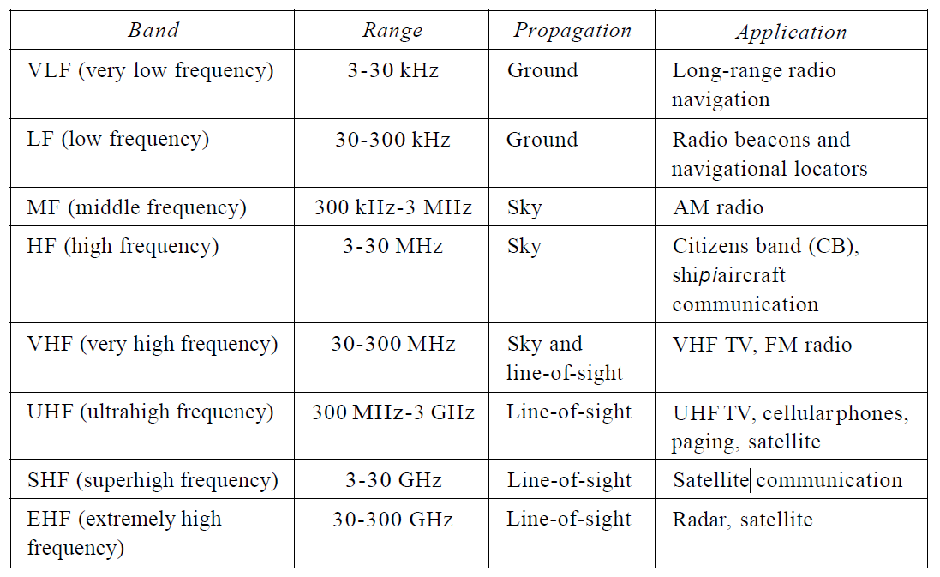
The section of the electromagnetic spectrum defined as radio waves and microwaves is divided into eight ranges, called bands, each regulated by government authorities.
These bands are rated from very low frequency (VLF) to extremely high frequency (EHF).

Slide 67
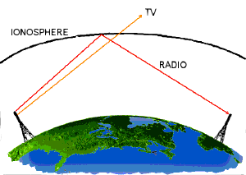
Radio Waves
Electromagnetic waves ranging in frequencies between 3 kHz and 1 GHz are normally called radio waves.
Radio waves, particularly those waves that propagate in the sky mode
radio waves a good candidate for long-distance broadcasting.
Radio waves use omnidirectional antennas that send out signals in all directions.
Applications:
multicasting-in which there is one sender but many receivers.
AM and FM radio, television, maritime radio, cordless phones, and paging

Slide 68
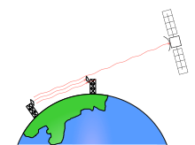
Microwaves
Electromagnetic waves having frequencies between 1 and 300 GHz are called microwaves.
Microwaves are unidirectional.
Microwave propagation is line-of-sight.
Applications:
Unicast - one-to-one communication is needed between the sender and the receiver.
cellular phones, satellite networks and wireless LANs

Slide 69

Infrared
Infrared waves, with frequencies from 300 GHz to 400 THz (wavelengths from 1 mm to 770 nm).
used for short-range communication.
line-of-sight propagation.
Applications:
used to transmit digital data with a very high data rate.

Slide 70
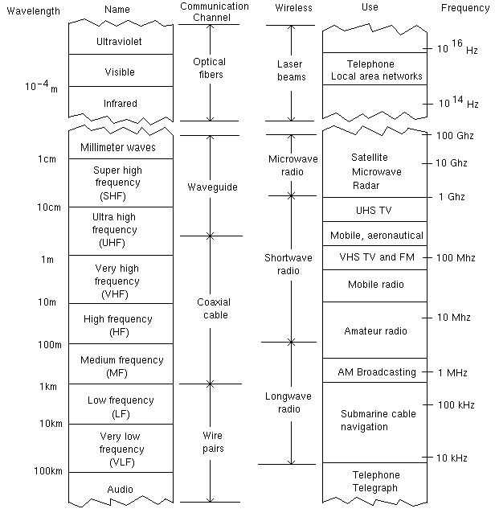

Slide 71
19Z504 COMPUTER NETWORKS
Unit 2 – Link Layer Services

Slide 72
UNIT 2 – LINK LAYER SERVICES
Link Layer Services
Framing
Flow Control
Error Control
Media Access Control
Ethernet
Wireless LAN
Introduction about
Bluetooth
Zigbee

